Slide 1
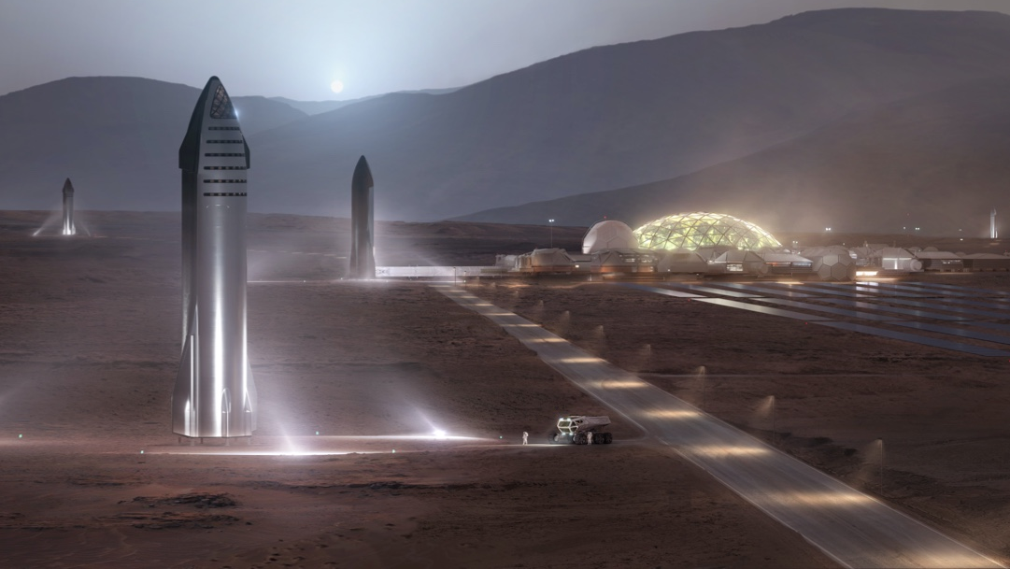
Envisioning SpaceX's First Stage Reusability An Analysis Through Data Science
Const Ferdin P
Aug 2023

Slide 2
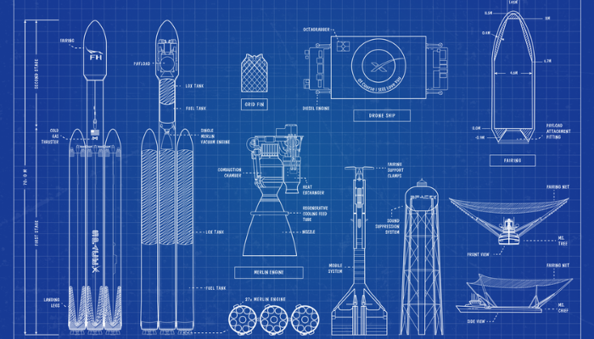
Table of Contents
Executive Summary
Introduction
Methodology
Results
Conclusion
Appendix
Discussion

Slide 3
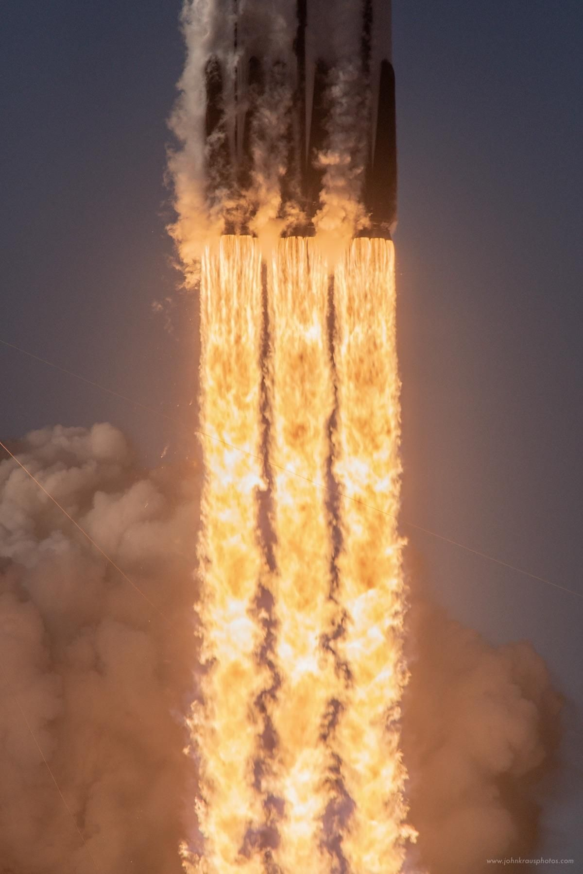
Executive Summary
The core objective of this project is to employ machine learning techniques to determine the success of the first stage's landing in SpaceX missions. By training a machine learning model, our aim is to accurately anticipate whether the initial part of the rocket will land safely and be fit for reuse in subsequent SpaceX endeavors.
Our project journey starts with gathering data using web scraping and organizing it through data wrangling. We then dive into exploring the data using SQL for analysis and creating visual displays. We take a step further by making interactive dashboards with tools like Plotly Dash and Folium for better data understanding.
As we move ahead, we venture into predictive analysis and machine learning. Using advanced algorithms, we aim to recognize patterns and predict outcomes. This step takes us closer to making accurate predictions. Our project not only explores the technical side of Falcon 9's first stage landings but also represents the spirit of using data to make informed decisions in the ever-changing field of space exploration.

Slide 4
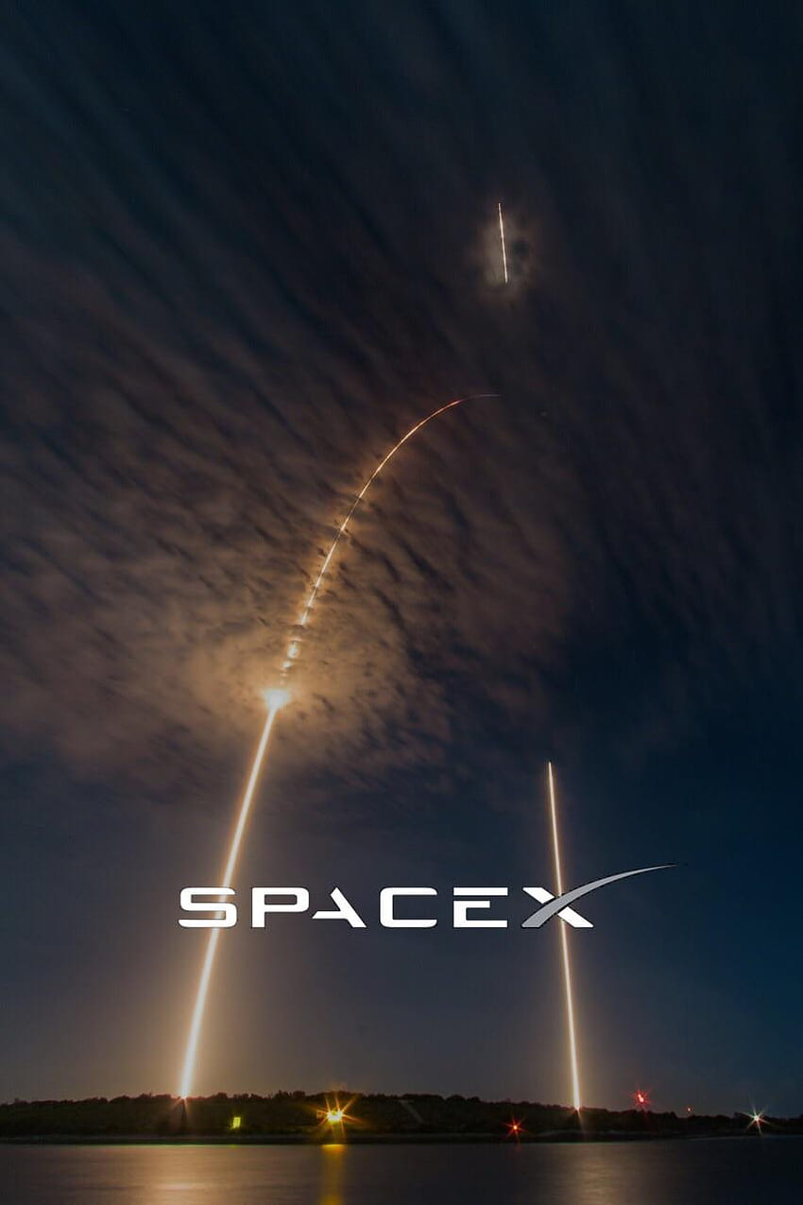
Introduction
Welcome to the era of space exploration that's within reach for all. Companies like Virgin Galactic, Rocket Lab, Blue Origin, and SpaceX are making space travel affordable and accessible. Among them, SpaceX stands out as one of the most successful players. They have achieved remarkable feats, like sending spaceships to the International Space Station, creating the Starlink satellite network for global internet access, and even launching missions with people on board. How does SpaceX manage this? One reason is that their rocket launches cost less compared to others.
SpaceX promotes Falcon 9 rocket launches on their website at a price of $62 million, a fraction of the $165 million charged by other companies. Their key strategy is reusing the first stage of the rocket, which is both crucial and expensive. This approach has sparked our interest in determining the landing success of this first stage, as it directly influences the cost of each launch.
Our focus in this project is to unravel the pricing puzzle of each launch. This hinges on whether the first stage can be safely landed and reused. We're armed with machine learning and armed with public data about the Falcon 9, we're aiming to predict whether SpaceX will opt to recycle this key component. Through the journey of this capstone project, we're embarking on a fascinating exploration where technology and data converge to shape the future of space endeavors.

Slide 5
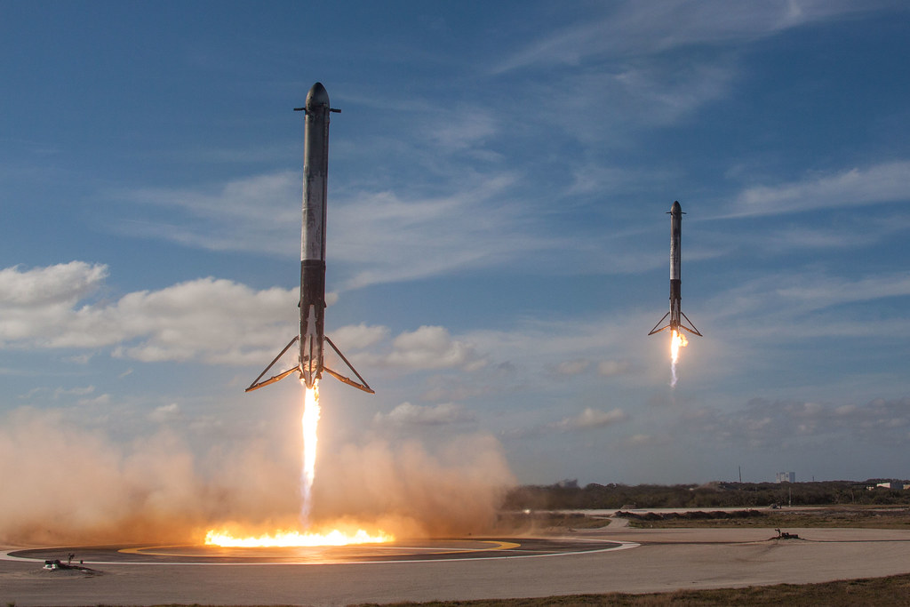
Methodology

Slide 6
Methodology
Phases :
Data collection :
Retrieve data from the SpaceX REST API and web scraping from Wiki pages.
Data wrangling :
Select the necessary attributes, address any missing values, and implement one-hot encoding for categorical variables in models that require numerical input.
Exploratory data analysis (EDA) using visualization and SQL
Build interactive visual analytics using Folium and Plotly Dash

Slide 7
Methodology
Phases :
Predictive analysis using classification models :
Standardize the data to ensure uniformity.
Train-test split: Divide the data into training and testing subsets.
Train the model and employ Grid Search to optimize hyperparameters.
Hyperparameter tuning: Identify the best hyperparameter values
Model comparison: Evaluate Logistic Regression, Support Vector Machines, Decision Tree Classifier, and K-nearest neighbors.
Accuracy assessment: Determine the most accurate model
Confusion matrix: Generate and analyze the confusion matrix for final evaluation.

Slide 8
Data Collection
For data collection, we utilized two main sources:
SpaceX API: We retrieved valuable data from the official SpaceX API available at https://api.spacexdata.com/v4/ . This API provided us with comprehensive information about various aspects of SpaceX missions, launches, and related details.
Web Scraping: In addition, we performed web scraping to gather Falcon 9 historical launch records from a Wikipedia page https://en.wikipedia.org/wiki/List_of_Falcon_9_and_Falcon_Heavy_launches
This involved extracting relevant data from the web page to enrich our dataset with historical launch records.

Slide 9
Data Collection – SpaceX API
Make a GET request to the SpaceX API to retrieve past launch data.
Define functions to retrieve specific information from the SpaceX API for different columns in the dataset.
Extract relevant information from the response and normalize it(json_normalize) into a pandas DataFrame.
Filter and format the data to keep only the necessary columns and process nested lists.
Apply the helper functions to retrieve specific data (booster version, launch site, payload data, core data) from the API.
Create a dictionary using the extracted data and create a pandas DataFrame.
Filter the DataFrame to include only Falcon 9 launches.
Reset the FlightNumber column to ensure continuous numbering.
Deal with missing values in the dataset.
GitHub URL : Python Code for Data Collection SpaceX API

Slide 10

Data Collection - Scraping
Steps to perform web scraping to collect Falcon 9 historical launch records from the Wikipedia page:
Request the Falcon9 Launch Wiki Page to create a BeautifulSoup object from the HTML response
Extract Column/Variable Names from HTML Table Header
Create an Empty Dictionary for Launch Data
Extract and Process Launch Data from Table Rows
Convert Dictionary to Pandas DataFrame
GitHub URL : Python code for Data Collection WebScrapping​

Slide 11
Data Wrangling
Overview :
In the data set, there are several different cases where the booster did not land successfully. Sometimes a landing was attempted but failed due to an accident; for example, True Ocean means the mission outcome was successfully landed to a specific region of the ocean while False Ocean means the mission outcome was unsuccessfully landed to a specific region of the ocean. True RTLS means the mission outcome was successfully landed to a ground pad False RTLS means the mission outcome was unsuccessfully landed to a ground pad. True ASDS means the mission outcome was successfully landed on a drone ship False ASDS means the mission outcome was unsuccessfully landed on a drone ship.
We will mainly convert those outcomes into Training Labels with 1 means the booster successfully landed 0 means it was unsuccessful.

Slide 12
Data Wrangling
Procedure:
Calculating Number of Launches on Each Site
Calculating Number and Occurrence of Each Orbit
Calculating Number and Occurrence of Mission Outcome per Orbit Type
Creating a Set of Unsuccessful Outcomes
Creating a Landing Outcome Label
Calculating Success Rate
GitHub URL : Python code for Spacex-Data Wrangling

Slide 13
EDA with Data Visualization
Performed Exploratory Data Visualization to understand the relation between :
Flight Number vs. Payload Mass Analysis
Launch Site vs. Success Rate Analysis
Success Rate vs. Orbit Type Analysis
Flight Number vs. Orbit Type Analysis
Payload vs. Orbit Type Analysis
Launch Success Yearly Trend Analysis
GitHub : Python code for EDA with Visualization SpaceX

Slide 14
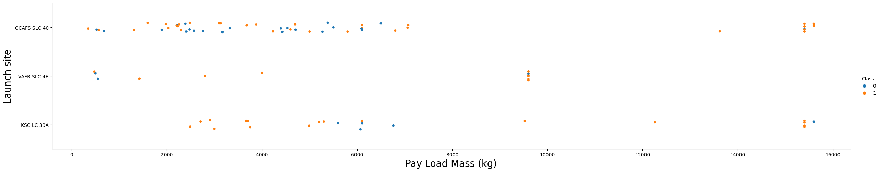
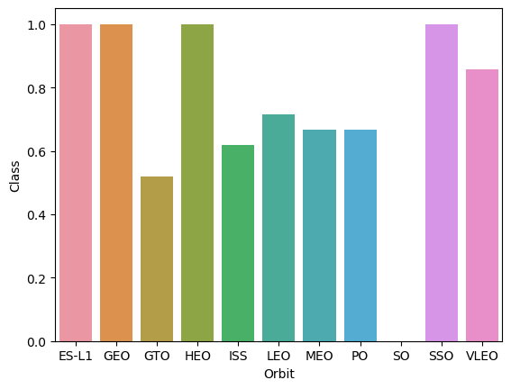
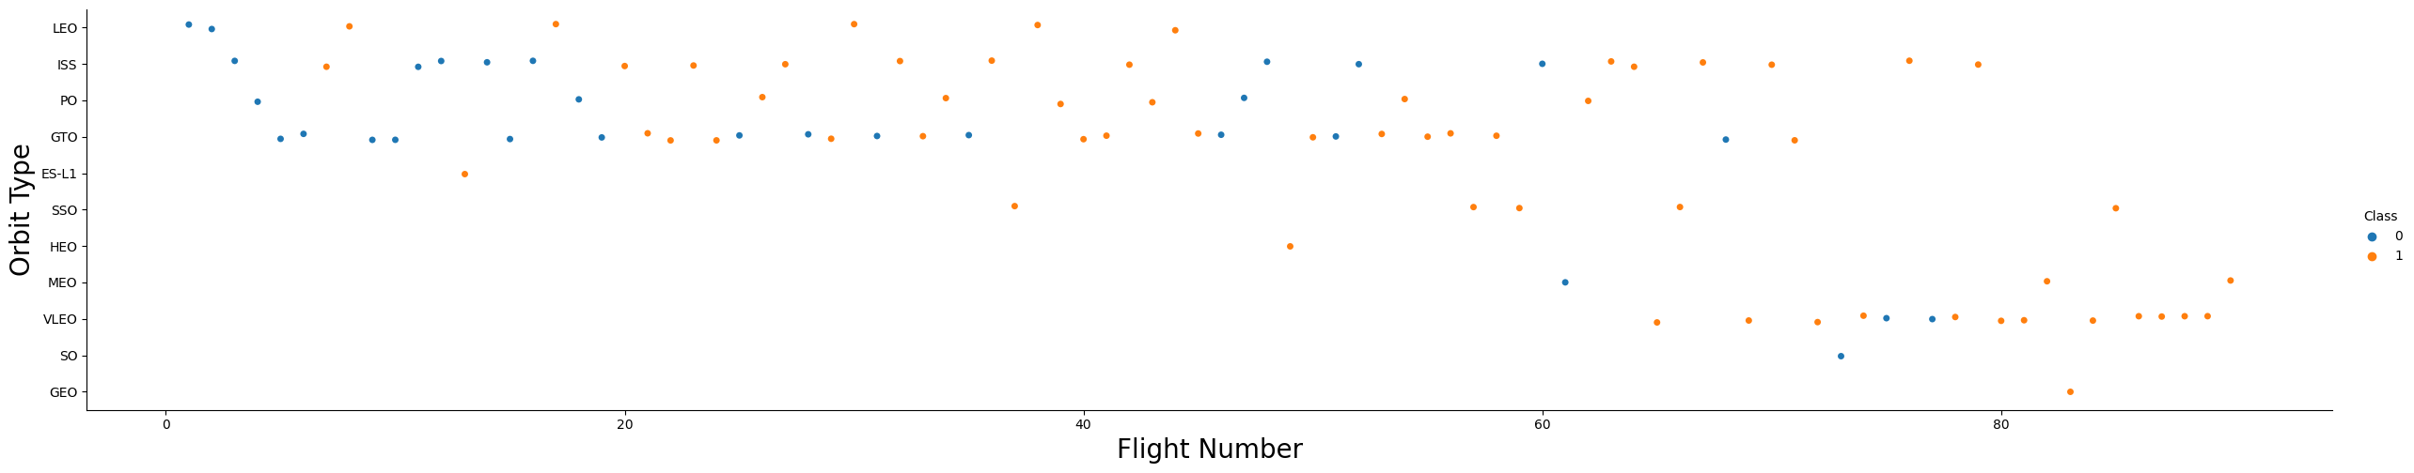
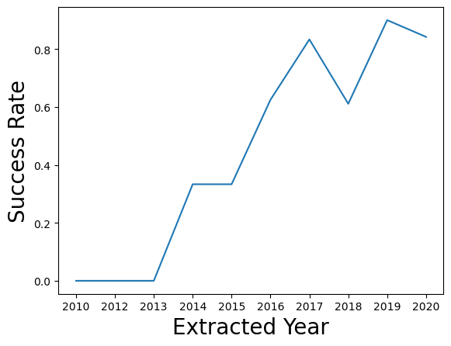
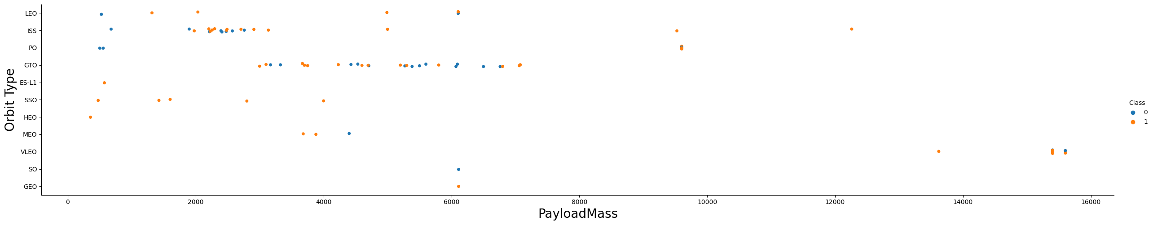
EDA with Data Visualization

Slide 15
EDA with SQL
Display the names of unique launch sites in the space mission.
Display 5 records where launch sites begin with the string 'CCA'.
Display the total payload mass carried by boosters launched by NASA (CRS).
Display the average payload mass carried by booster version F9 v1.1.
List the date when the first successful landing outcome on a ground pad was achieved.
List the names of boosters that have success in drone ship landings and have payload mass between 4000 and 6000 kg.
List the total number of successful and failure mission outcomes.
List the names of booster versions that have carried the maximum payload mass.
List the records displaying month names, failure landing outcomes in drone ships, booster versions, and launch sites for the months in the year 2015.
Rank the count of landing outcomes between specified dates in descending order.
GitHub : Python code for SpaceX-EDA-SQL

Slide 16
Build an Interactive Map with Folium
Tasks Performed:
Mark all launch sites on a map: The purpose here is to visually represent the geographic locations of SpaceX launch sites. This helps in understanding the distribution of launch sites around the world.
Mark success/failed launches for each site on the map: This task aims to enhance the map by adding markers that represent the success or failure of each launch from a specific site. It provides a quick visual overview of the launch success rates at different sites.
Calculate distances between a launch site and its proximities: This task involves calculating the distances between a launch site and various points of interest such as coastlines, cities, railways, and highways. By visualizing these distances on the map, we can understand how close the launch sites are to these features.
GitHub URL : Python code for Interactive Map with Folium

Slide 17
Build a Dashboard with Plotly Dash
Created App: A Dash application instance called app was set up for building the dashboard.
Layout Setup: The dashboard layout was defined using an HTML Div element to structure the components.
Dropdown for Launch Sites: A dropdown list using dcc.Dropdown was added for users to select launch sites. Options included "All Sites" and specific sites.
Pie Chart for Success: A pie chart (dcc.Graph) was included to display successful launch counts. A callback was created to update the chart based on selected sites.
Slider for Payload Range: A range slider (dcc.RangeSlider) was implemented for users to choose payload ranges.
Scatter Chart for Payload vs. Success: A scatter chart (dcc.Graph) was added to show payload vs. launch success. A callback was created to update it based on selected sites and payload range.
Callback for Charts: Callback functions were created using @app.callback decorator to update pie and scatter charts based on user selections.
Ran the App: The script was run as the main program, and app.run_server() was used to start the Dash app server.
GitHub URL : Python code for Interactive Dashboard with Ploty Dash

Slide 18
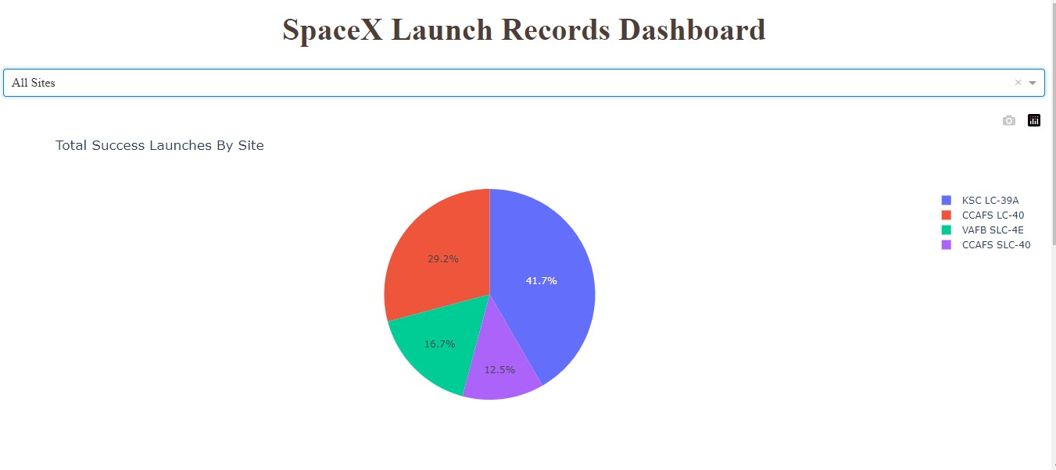
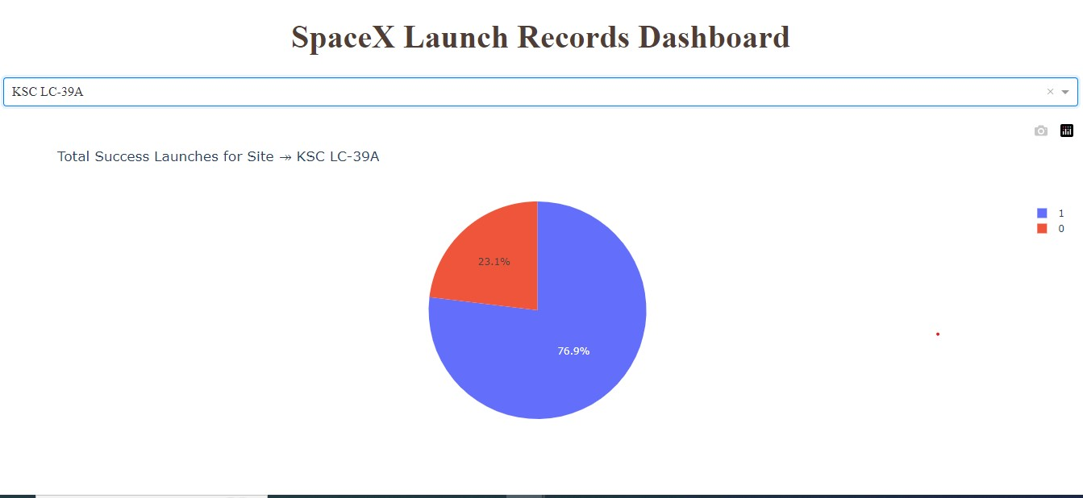
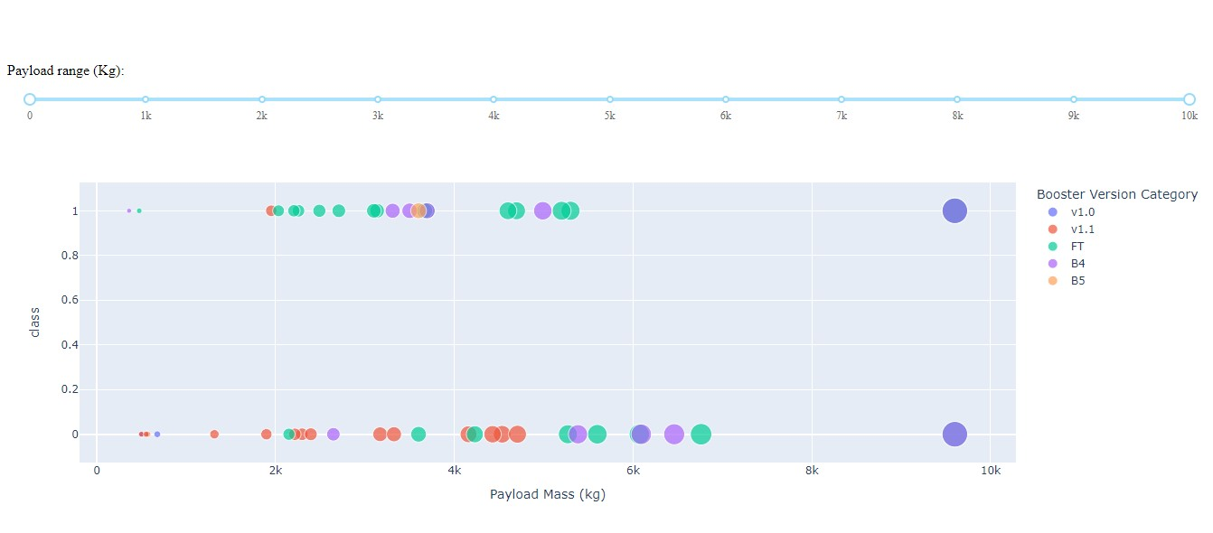
Build a Dashboard with Plotly Dash

Slide 19
Predictive Analysis (Classification)
In the process of having built, evaluated, improved, and found the best performing classification model for predicting the success of Space X Falcon 9 first stage landings, the following steps had been taken:
Objective Definition:
The goal had been to predict if the first stage of a Falcon 9 rocket would successfully land based on provided data.
Data Collection and Preparation:
Data containing various features related to launches and outcomes had been loaded.
Features had been standardized for consistent processing.
Data Splitting:
The dataset had been split into training and testing sets to validate model performance.
Model Selection and Tuning:
Different classification algorithms had been considered: Logistic Regression, Support Vector Machine, Decision Tree, and K Nearest Neighbors.
GridSearchCV had been used to tune hyperparameters for each algorithm to improve performance.
Model Training and Evaluation:
Models had been trained on the training dataset using the tuned hyperparameters.
Model accuracy had been evaluated using cross-validation scores.
Model Comparison and Selection:
The performance of each model had been compared using their cross-validation scores.
The model with the highest accuracy had been selected as the best performing model.

Slide 20
Predictive Analysis (Classification)
Confusion Matrix Analysis:
Confusion matrices had been plotted for each model on the test dataset.
These matrices had shown how well the models had been predicting each class (landed or not landed).
Final Model Selection and Parameters:
The Decision Tree model had been identified as the best performing model with the highest accuracy.
The best hyperparameters for the Decision Tree model had been identified.
Model Performance on Test Data:
The selected Decision Tree model had been evaluated on the test dataset to calculate its accuracy.
Best Method Determination:
The performance scores of all models had been compared.
The Decision Tree model had been identified as the best method with the highest accuracy.
The hyperparameters of the best model had been displayed.
Overall, the model development process had involved selecting multiple classification algorithms, tuning their hyperparameters, evaluating their performance, and selecting the best performing model based on accuracy. The Decision Tree model had emerged as the most accurate method for predicting the success of Space X Falcon 9 first stage landings.
The process had iterated over steps like model selection, tuning, and evaluation until the best model had been identified. The selected model had then been evaluated on test data, and the best method had been determined based on its accuracy.
GitHub URL : Machine Learning Prediction - Python Code

Slide 21
Results
Overview
The results of the findings from the SpaceX Falcon 9 First Stage Landing Prediction are as follows:
As the flight number increases, the first stage is more likely to land successfully.
Payload mass influences landing success; heavier payloads tend to have a lower success rate.
Different launch sites have varying success rates. CCAFS LC-40 has a success rate of 60%, while KSC LC-39A and VAFB SLC 4E have a success rate of 77%.
Success rates also differ based on the orbit type. Orbits like ES-L1, GEO, HEO, and SSO have higher success rates.
In LEO orbit, the success appears related to the number of flights.
Success rates have increased since 2013.
The performance of the models was quite comparable on the test set, with the decision tree model demonstrating a slightly superior performance.

Slide 22
Results
Exploratory data analysis results
Interactive analytics demo in screenshots
Predictive analysis results

Slide 23
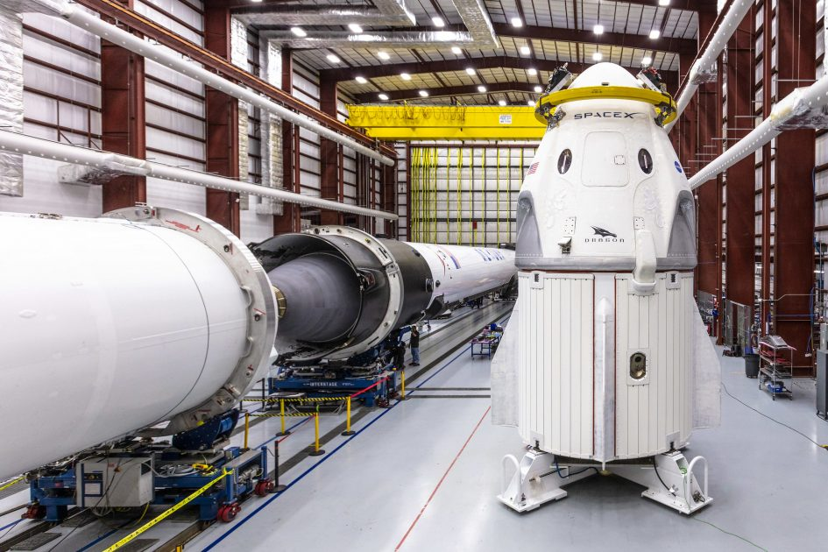
Insights Drawn from EDA

Slide 24
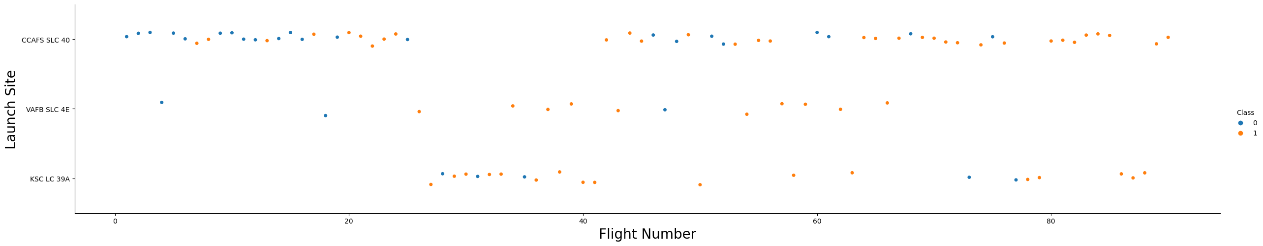
Flight Number vs. Launch Site
Flight Number on the x-axis and Launch Site on the y-axis, with colors indicating success(1) or failure(0). This plot highlights the success rates of different launch sites.
The majority of the launches were executed from CCAFS SLC 40.
The success rate at CCAFS LC-40 stands at 60%, whereas KSC LC-39A and VAFB SLC 4E exhibit success rates of 77%.
The success rate of launches exhibited an improvement compared to the outcomes of earlier launch attempts.

Slide 25
Payload vs. Launch Site
It is observed that for the VAFB-SLC launch site, there are no launches with heavy payload masses (greater than 10000 kg).
Many launches that involve payloads greater than 7000 kg experience a relatively high rate of success during the launch process.
The VAFB SLC 4E launch site is not used for payloads exceeding 10000 kg.

Slide 26
Success Rate vs. Orbit Type
ES-L1, GEO, HEO, and SSO orbits have higher success rates compared to other orbit types.

Slide 27

Flight Number vs. Orbit Type
Success within the LEO orbit demonstrates a clear association with the frequency of flights.
However, in the case of the GTO orbit, there seems to be no significant correlation between the flight number and the success rate.

Slide 28

Payload vs. Orbit Type
Positive landing rates for heavy payloads are notably higher in Polar, LEO, and ISS orbits.
In contrast, distinguishing between positive and negative landing outcomes is challenging within the GTO orbit due to the coexistence of both.

Slide 29

Launch Success Yearly Trend
The success rate has been consistently rising from 2013 to 2020, as evident from the observation.

Slide 30
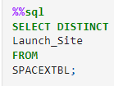
Launch Sites Names
SpaceX employs a total of four distinct launch sites for their space missions. Each of these launch sites serves as a strategic location from which SpaceX conducts its spacecraft launches, showcasing the company's operational diversity and technological proficiency.
Launch_Sites
CCAFS LC-40
VAFB SLC-4E
KSC LC-39A
CCAFS SLC-40

Slide 31
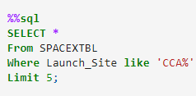
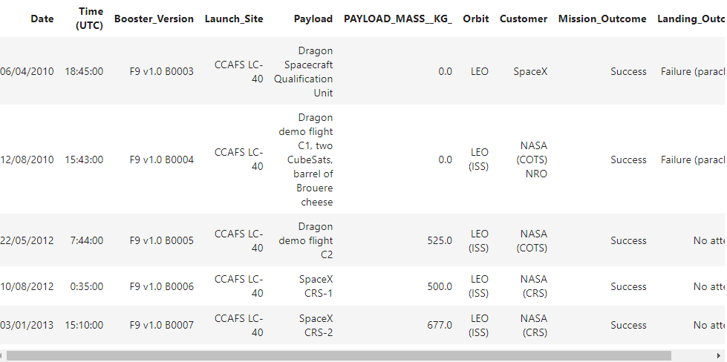
Launch Site Names Begin with 'CCA'
Code Review: WHERE Launch_Site like 'CCA%': This is a condition applied to the data. It filters the rows where the value in the "Launch_Site" column starts with 'CCA'. The % symbol is a wildcard that allows for any characters to follow 'CCA'.

Slide 32
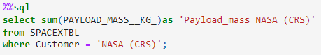
Total Payload Mass
NASA (CRS) has carried a total payload mass of 45,596 kg.
The code calculates the total payload mass carried by NASA (CRS) from the "SPACEXTBL" dataset and presents the result as "Payload_mass NASA (CRS)". It achieves this by summing the values in the "PAYLOAD_MASS__KG_" column where the customer is identified as "NASA (CRS)".

Slide 33
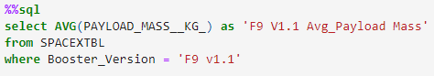
Average Payload Mass by F9 v1.1
The average payload mass for F9 V1.1 is 2928.4 kilograms.
This code calculates the average payload mass for launches using the F9 V1.1 booster. It selects the average value of the 'PAYLOAD_MASS__KG_' column from the 'SPACEXTBL' table where the 'Booster_Version' is specified as 'F9 v1.1'. The result is displayed with the column name 'F9 V1.1 Avg_Payload Mass'.

Slide 34
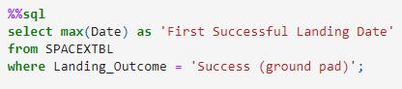
First Successful Ground Landing Date
The date of the first successful landing was December 22, 2015.
This code finds the earliest successful ground pad landing date by selecting the maximum date from the "SPACEXTBL" table where the landing outcome is marked as a success.

Slide 35
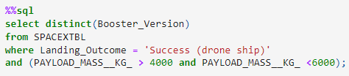
Successful Drone Ship Landing with Payload between 4000 and 6000
Names of boosters which have successfully landed on drone ship and had payload mass greater than 4000 but less than 6000:
F9 FT B1022
F9 FT B1026
F9 FT B1021.2
F9 FT B1031.2
The code retrieves unique booster versions from the "SPACEXTBL" table where the landing outcome is categorized as a success on a drone ship and the payload mass falls within the range of 4000 to 6000 kg.

Slide 36
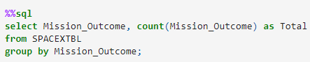
Total Number of Successful and Failure Mission Outcomes
Mission Outcome | Total
Failure (in flight) | 1
Success | 99
Success (payload status unclear) | 1

Slide 37
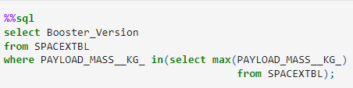
Boosters Carried Maximum Payload
Booster_Version
F9 B5 B1048.4
F9 B5 B1049.4
F9 B5 B1051.3
F9 B5 B1056.4
F9 B5 B1048.5
F9 B5 B1051.4
F9 B5 B1049.5
F9 B5 B1060.2
F9 B5 B1058.3
F9 B5 B1051.6
F9 B5 B1060.3
F9 B5 B1049.7

Slide 38
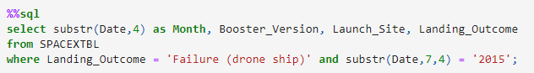
2015 Launch Records
The failed landing outcomes on the drone ship, along with their booster versions and launch site names, for the year 2015:
Month | Booster_Version | Launch_Site | Landing_Outcome
10/2015 | F9 v1.1 B1012 | CCAFS LC-40 | Failure (drone ship)
04/2015 | F9 v1.1 B1015 | CCAFS LC-40 | Failure (drone ship)

Slide 39
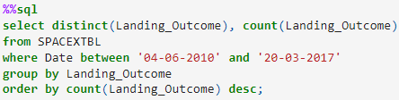
Count of Landing Outcomes Between 2010-06-04 and 2017-03-20
Landing_Outcome | Count
Success | 20
No attempt | 10
Success (drone ship) | 8
Success (ground pad) | 7
Failure (drone ship) | 3
Failure | 3
Failure (parachute) | 2
Controlled (ocean) | 2
No attempt | 1

Slide 40
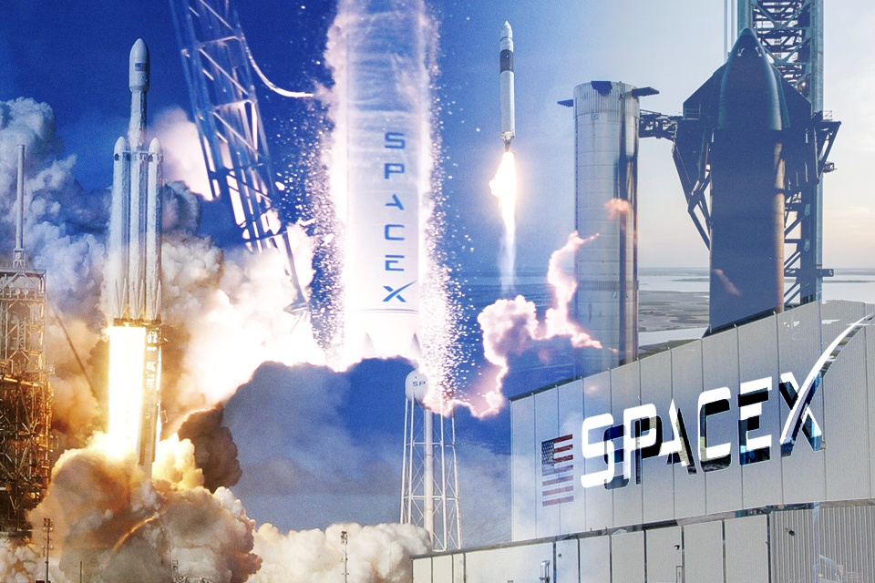
Launch Sites Proximities Analysis

Slide 41
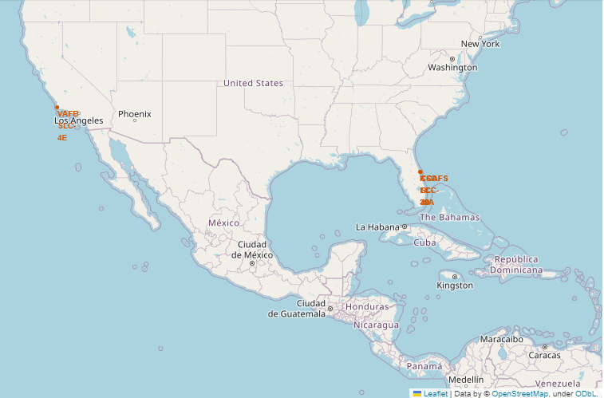
SpaceX Launch Sites
SpaceX has multiple launch sites in different geographic locations. This diversity allows them to choose the most suitable site based on factors such as orbital requirements, trajectory optimization, and weather conditions.
With launch sites on both the East and West Coasts of the United States, SpaceX can efficiently serve a wide range of customers with diverse mission requirements from around the world.
SpaceX has a launch site that is relatively close to the equator. Equatorial launch sites, such as those located near the Earth's equator, provide certain benefits due to the higher rotational velocity of the Earth at the equator. This additional rotational velocity can provide an extra boost to rockets during launch, allowing them to achieve higher payload capacities or require less fuel to reach the desired orbit.

Slide 42
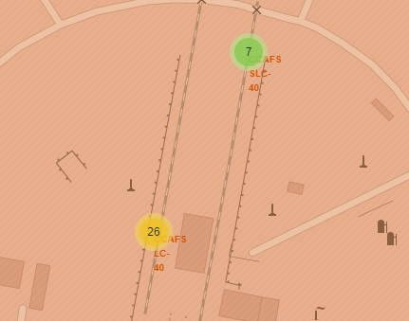
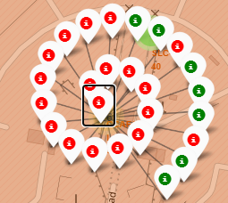
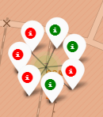
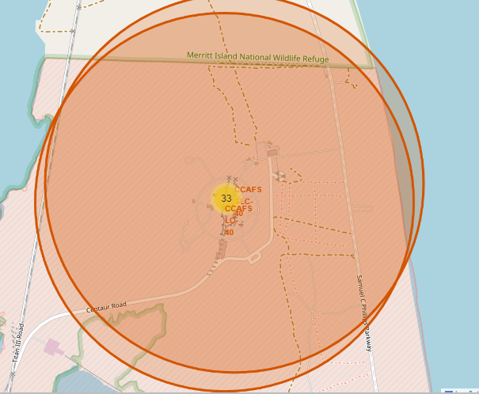
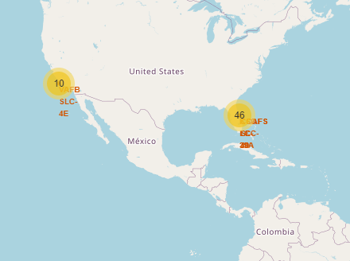
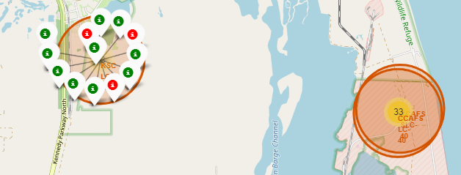
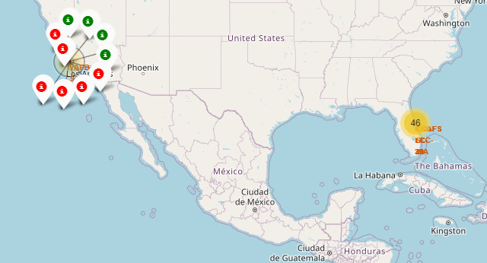
Launch Sites Launch Outcome
Green markers indicate successful launches.
Red markers represent unsuccessful launches.

Slide 43
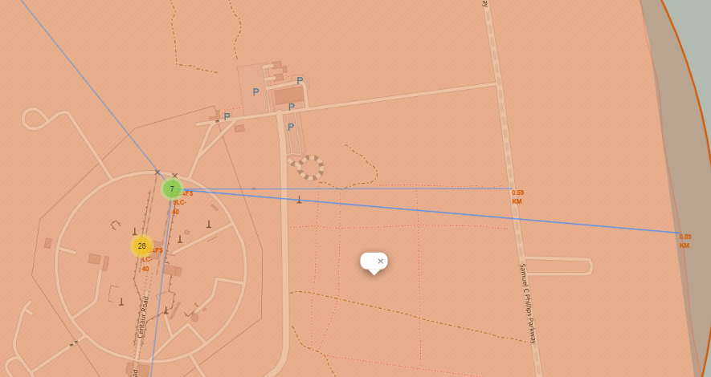
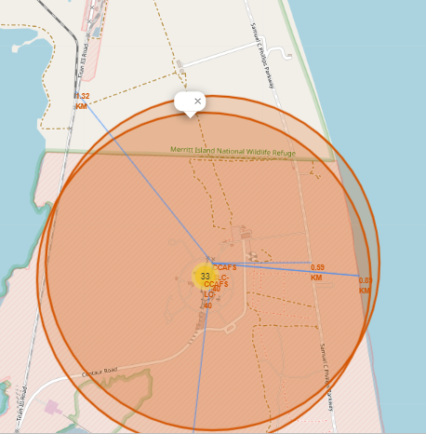
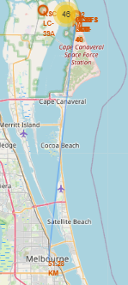
Distance of Proximities
Distance to Coast - 0.89 km
Distance to Highway - 0.59 km
Distance to Railway – 1.32 km
Distance to Nearest city (Melbourne) - 51.28 Km

Slide 44
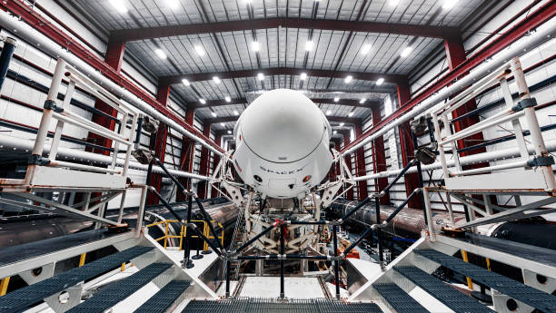
Dashboard with Plotly Dash

Slide 45
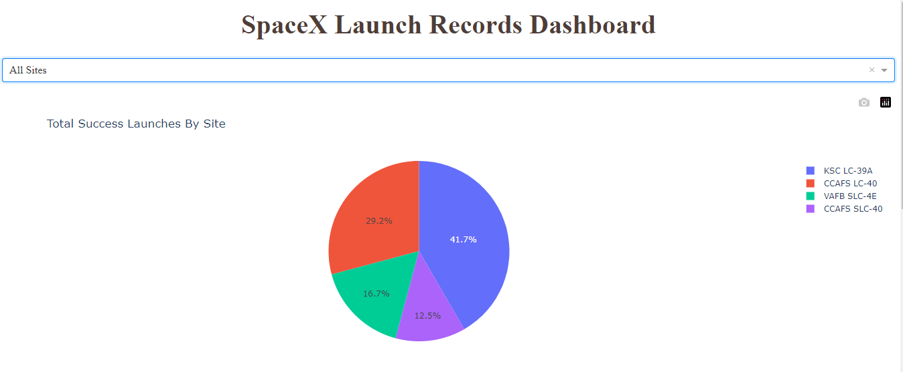
Dashboard - Successful Launches by Sites
Percentage of Successful Launches across All Launch Sites:
Among the launch sites, KSC LC-39A boasts the highest success rate in launches (41.2%).

Slide 46
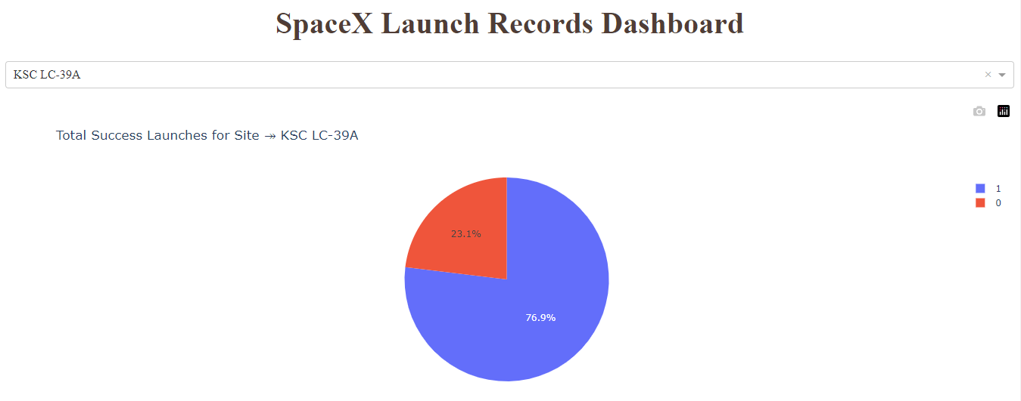
Launch Site with Highest Launch Success Ratio
KSC LC-39A achieved the highest success rate of 76.9%, with a corresponding failure rate of 23.1%.

Slide 47
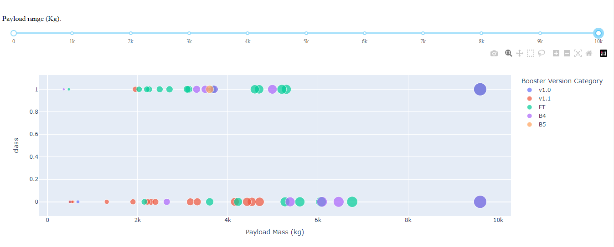
DASHBOARD – Payload vs. Launch Outcome
The success rate is highest for payloads with weights between 2,000 kg and 5,000 kg.
Unit 1 indicates success, while unit 0 indicates failure.

Slide 48
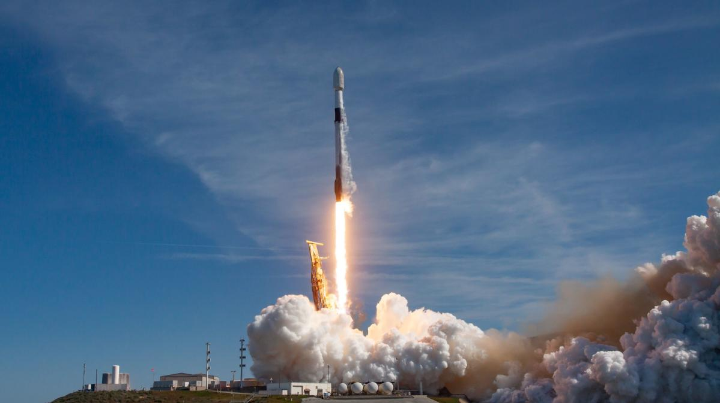
Predictive Analysis (Classification)

Slide 49
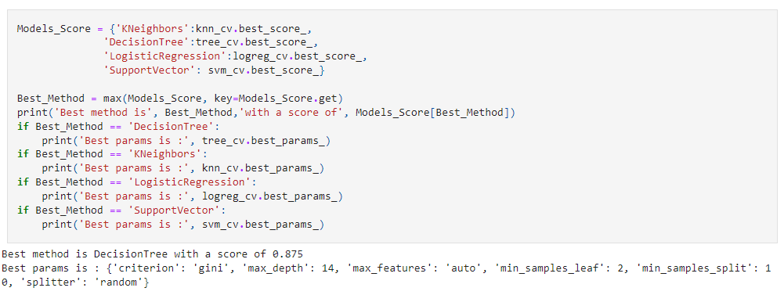
Classification Accuracy
Logistic Regression:​
Best Accuracy: 0.8464285714285713​
Test Accuracy: 0.8333333333333334​
Support Vector Machine (SVM):​
Best Accuracy: 0.8482142857142856​
Test Accuracy: 0.8333333333333334​
Decision Tree:​
Best Accuracy: 0.875​
Test Accuracy: 0.8333333333333334​
K Nearest Neighbors (KNN):​
Best Accuracy: 0.8482142857142858​
Test Accuracy: 0.8333333333333334​
The Decision Tree model achieved the highest accuracy score among all the tested algorithms. An accuracy score of approximately 87.5% was obtained, which indicates that the model correctly predicted the outcomes of the first stage landing in a significant proportion of cases. This high accuracy suggests that the Decision Tree model is well-suited to the problem and is capable of distinguishing between successful and unsuccessful landings.

Slide 50

Confusion Matrix
The confusion matrix of the Decision Tree provides insights into how well the model performed in classifying whether the first stage of a SpaceX Falcon 9 rocket would land successfully or not.
In the context of the Decision Tree classifier that was evaluated, the confusion matrix outputs are as follows:
True Positives (TP): The model correctly predicted 12 instances where the first stage of a SpaceX Falcon 9 rocket would land successfully (Landed).
True Negatives (TN): The model correctly predicted 3 instances where the first stage of the rocket would not land successfully (Not Landed).
False Positives (FP): The model incorrectly predicted 3 instances where the first stage would land successfully when it didn't (Type I error).
False Negatives (FN): The model incorrectly predicted 0 instances where the first stage wouldn't land successfully when it did (Type II error).
Accuracy: (TP + TN) / (TP + TN + FP + FN), which is (12 + 3) / (12 + 3 + 3 + 0) = 15 / 18 ≈ 0.833.
Precision: TP / (TP + FP). In this case, it's 12 / (12 + 3) = 0.8.
Recall : TP / (TP + FN). In this case, it's 12 / (12 + 0) = 1.
F1-Score: 2 * (Precision * Recall) / (Precision + Recall). In this case, it's 2 * (0.8 * 1) / (0.8 + 1) ≈ 0.888.
The model seems to be particularly good at correctly identifying successful landings .

Slide 51
Conclusions
Concluding Insights from SpaceX Launch Analysis
In this comprehensive analysis of SpaceX's launch data, we've uncovered a wealth of insights that shed light on the success and patterns of their rocket launches. By visualizing the relationship between Flight Number and Launch Site, we've discerned key success rates across different launch sites.
Among the launch sites, CCAFS LC-40 was the most frequently used, with a success rate of 60%. Meanwhile, KSC LC-39A and VAFB SLC 4E exhibited even higher success rates at 77%. This indicates a positive trend in launch success rates over time.
Notably, launches from VAFB-SLC were absent for heavy payloads exceeding 10000 kg, while launches with payloads greater than 7000 kg had a higher success rate. The VAFB SLC 4E launch site's limitation to payloads under 10000 kg suggests a targeted strategy for optimal performance.
An interesting revelation was the superior success rates in orbits like ES-L1, GEO, HEO, and SSO. In particular, success within the Low Earth Orbit (LEO) showed a correlation with flight frequency. However, the Geostationary Transfer Orbit (GTO) exhibited no significant correlation between flight number and success rate.
With respect to landing outcomes, heavy payloads showed better positive landing rates in Polar, LEO, and ISS orbits, while distinguishing between positive and negative landings in the GTO orbit posed challenges.
The temporal evolution of SpaceX's launch success rates indicated consistent improvement from 2013 to 2020, reflecting the company's dedication to refining their processes.
SpaceX's strategic geographic distribution of launch sites, including equatorial sites like KSC LC-39A, enables them to cater to diverse mission requirements efficiently. Equatorial launch sites capitalize on Earth's rotational velocity to enhance rocket performance, translating to higher payload capacities or fuel efficiency.
The analysis culminated in the Decision Tree model's impressive performance, achieving an accuracy of approximately 87.5%. This model effectively predicted first stage landing outcomes, emphasizing its significance in distinguishing successful and unsuccessful landings.
In conclusion, our analysis provides valuable insights into SpaceX's launch operations, success rates, orbit dynamics, and the efficacy of predictive models. As SpaceX continues to pioneer space exploration, these findings underscore the role of data-driven insights in shaping the future of aerospace endeavors.

Slide 52
Appendix
Implementing Machine Learning in Real-Time Production
This appendix provides a comprehensive overview of the process involved in implementing machine learning models in real-time production environments. The following steps outline the key considerations for a successful transition from model development to deployment and monitoring:
1. Data Collection and Preparation:
Gather real-time data from sources such as sensors, APIs, or databases.
Ensure data quality and consistency through preprocessing and feature engineering.
2. Model Selection and Training:
Choose a suitable machine learning algorithm and optimize its performance.
Employ techniques like cross-validation and hyperparameter tuning.
3. Model Deployment:
Develop a deployment-ready model version.
Select a deployment environment, including on-premises or cloud platforms.
Implement the model as an API using frameworks like Flask or FastAPI.

Slide 53
Appendix
4. Real-Time Prediction:
Establish an infrastructure to process real-time data and feed it to the model.
Configure API endpoints for predictions, ensuring low latency.
5. Scalability and Load Balancing:
Implement load balancing mechanisms for even request distribution.
Monitor performance and scale resources as needed.
6. Monitoring and Maintenance:
Continuously monitor model performance and health in real-time.
Detect anomalies, concept drift, and data issues using monitoring tools.
Periodically update the model with new data to improve accuracy.
7. Security and Privacy:
Secure API endpoints with authentication and authorization mechanisms.
Encrypt sensitive data to ensure privacy and regulatory compliance.
8. Feedback Loop and Updates:
Gather user feedback and performance metrics to identify improvements.
Update and retrain the model based on feedback.
Use automated update processes through CI/CD pipelines.

Slide 54
Appendix
9. Testing and Quality Assurance:
Thoroughly test the deployment pipeline and use A/B testing or canary releases.
Monitor model performance post-updates to ensure expectations are met.
10. Documentation and Collaboration:
Maintain comprehensive documentation of the deployment process, APIs, and configurations.
Foster collaboration among different teams for effective communication.
11. Cost Management:
Consider infrastructure, maintenance, and monitoring costs.
Optimize resource usage for cost-effectiveness.
12. Training and Support:
Train operational teams for monitoring and issue resolution.
Provide user support channels for feedback and reporting.
By following these steps, organizations can successfully implement machine learning models in real-time production environments, enabling them to make data-driven decisions and achieve operational efficiency. This comprehensive approach ensures a seamless integration of machine learning capabilities into real-world applications.

Slide 55

Thank you

